Slide 1
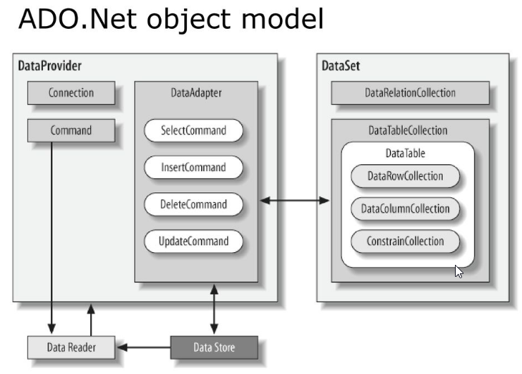
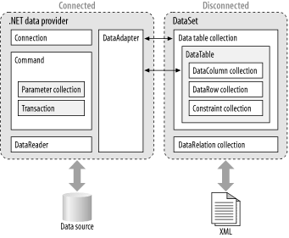
https://slideplayer.com/slide/17154334/
https://www.oreilly.com/library/view/adonet-in-a/0596003617/ch01s02.html

